Slide 1
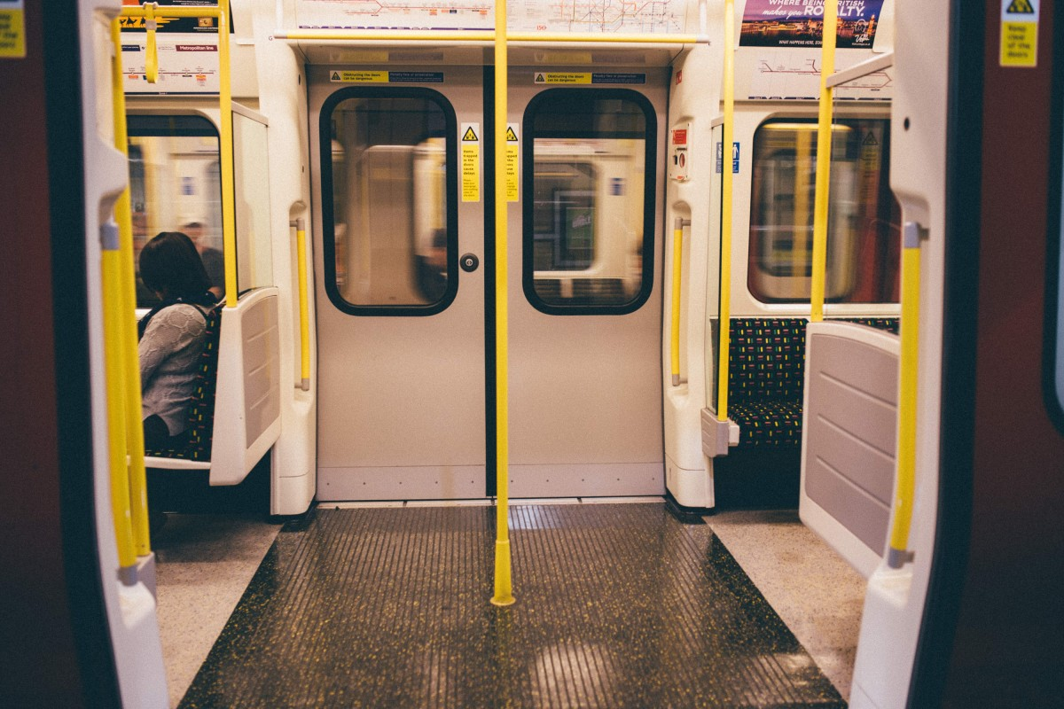

TRACQR
MOBILON-
Sanya Wadhawan
E23CSEU0872

Slide 2
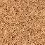
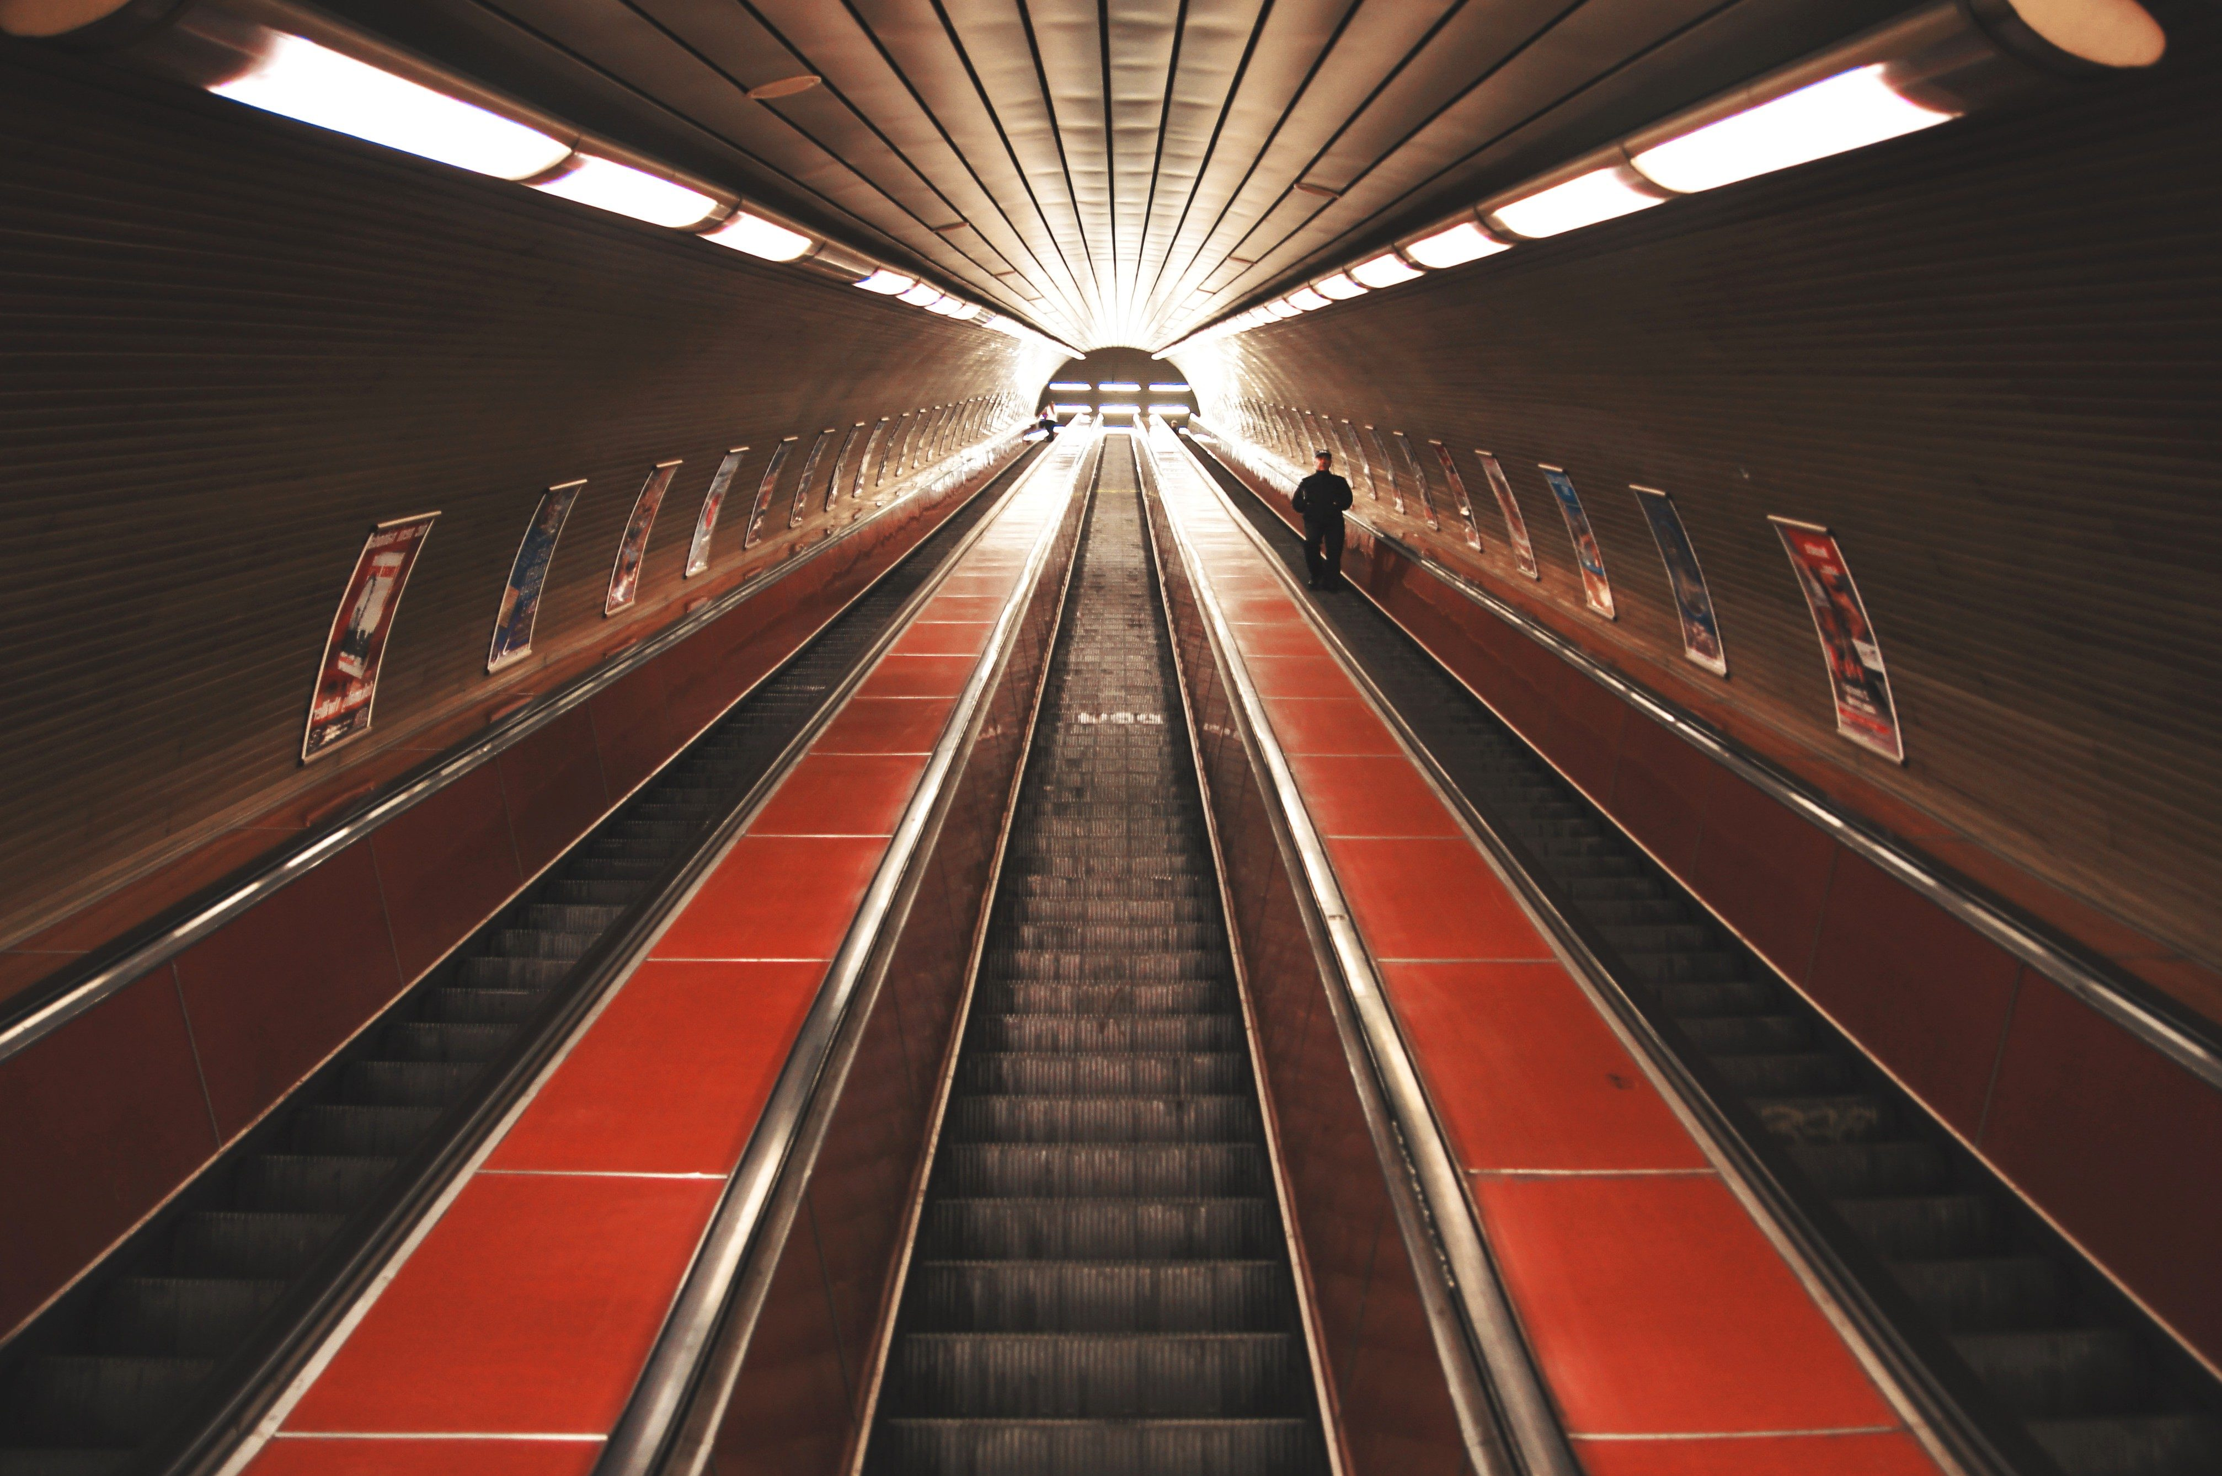
IDEA
This website provides a platform for passengers to:
Easily locate their nearest metro stations,
Provide a GPS featured map of metro lines,
Book their tickets through online payment using blockchain,
Keep easy track of a single QR for each checkpoint,
Make the onboarding process effortless and quick.

Slide 3
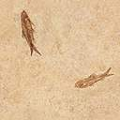
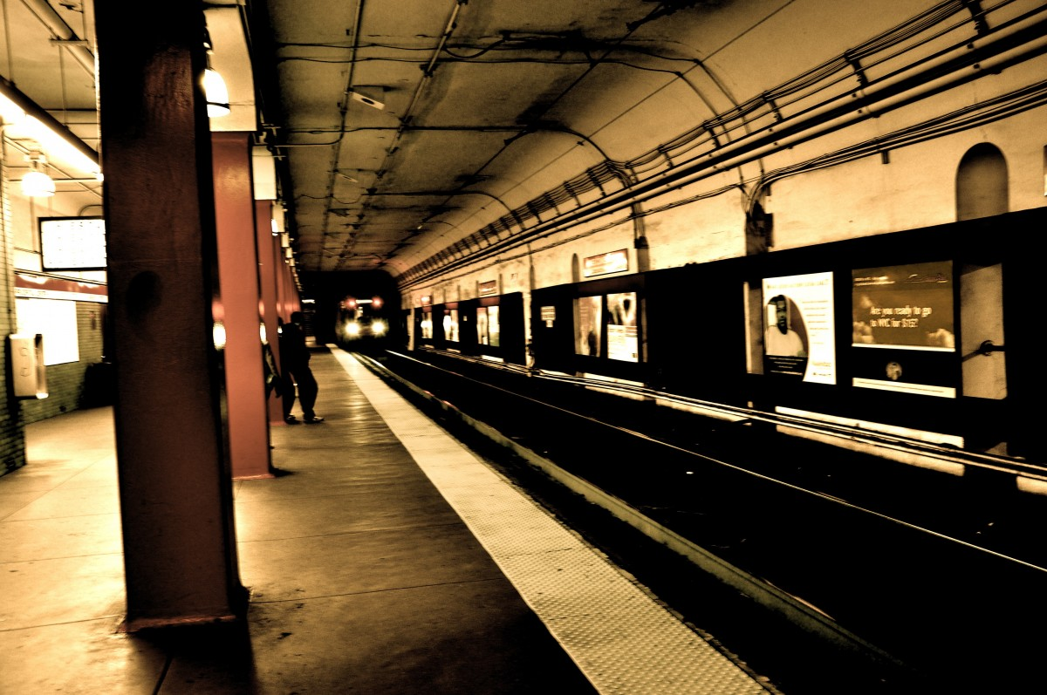
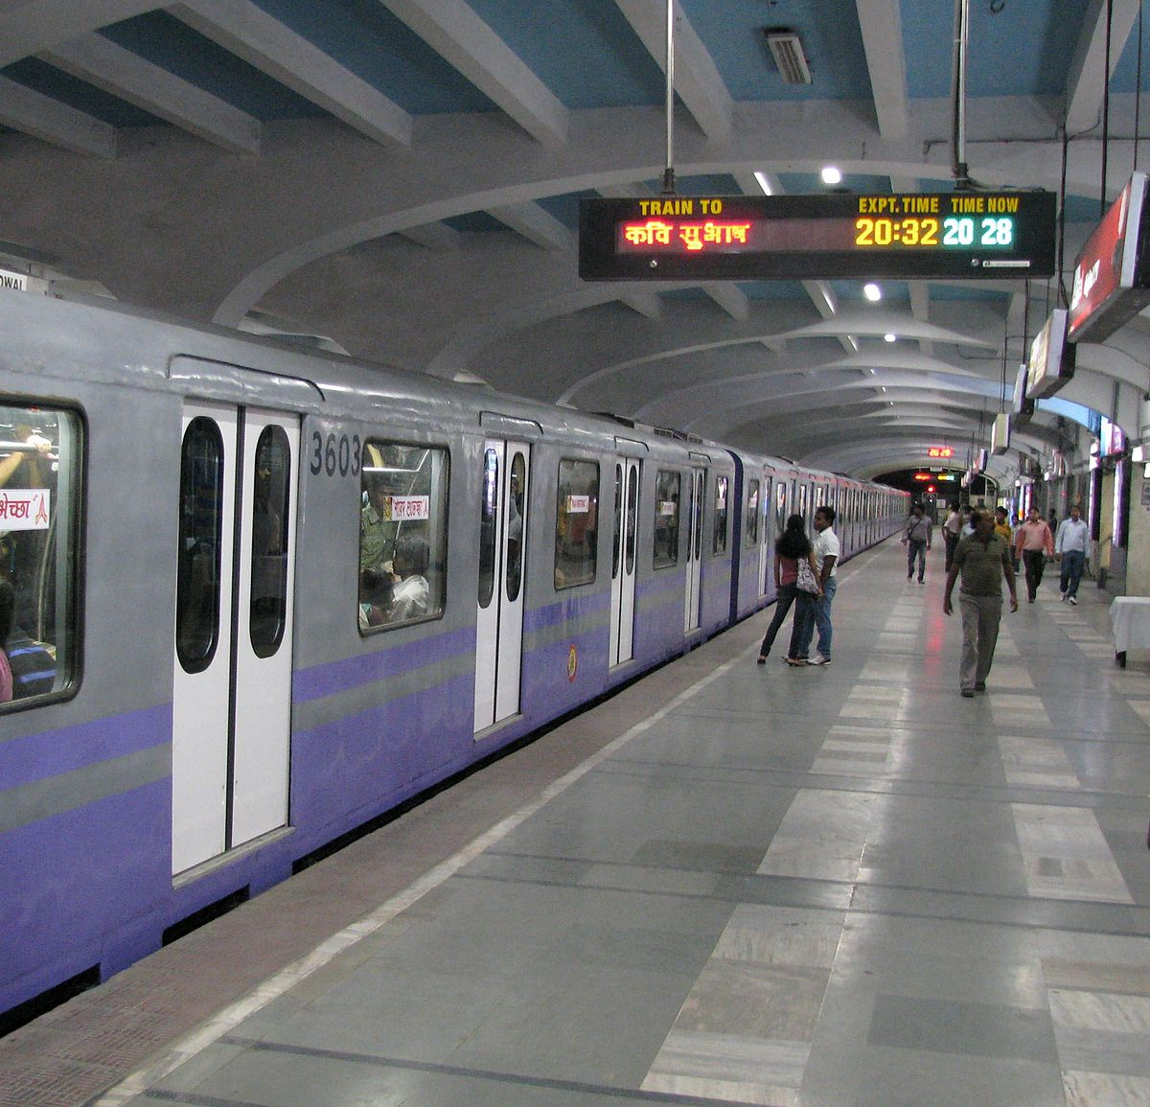
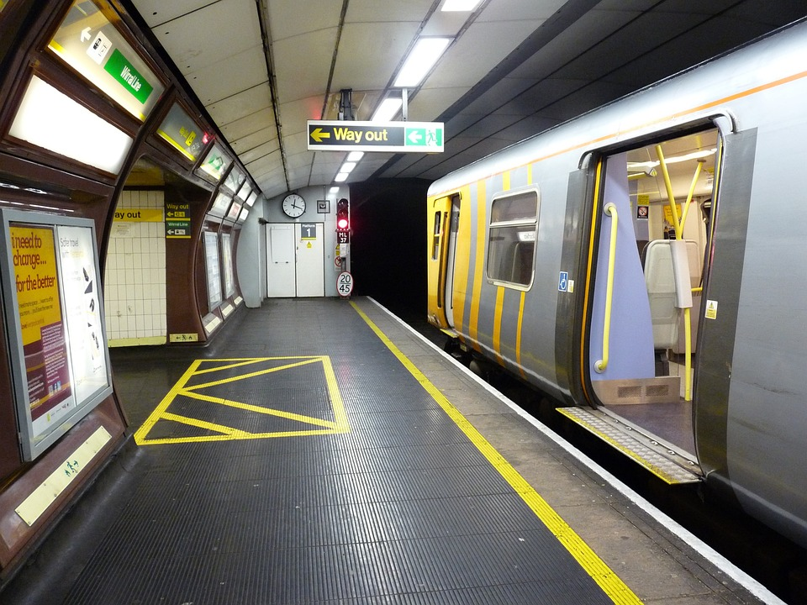
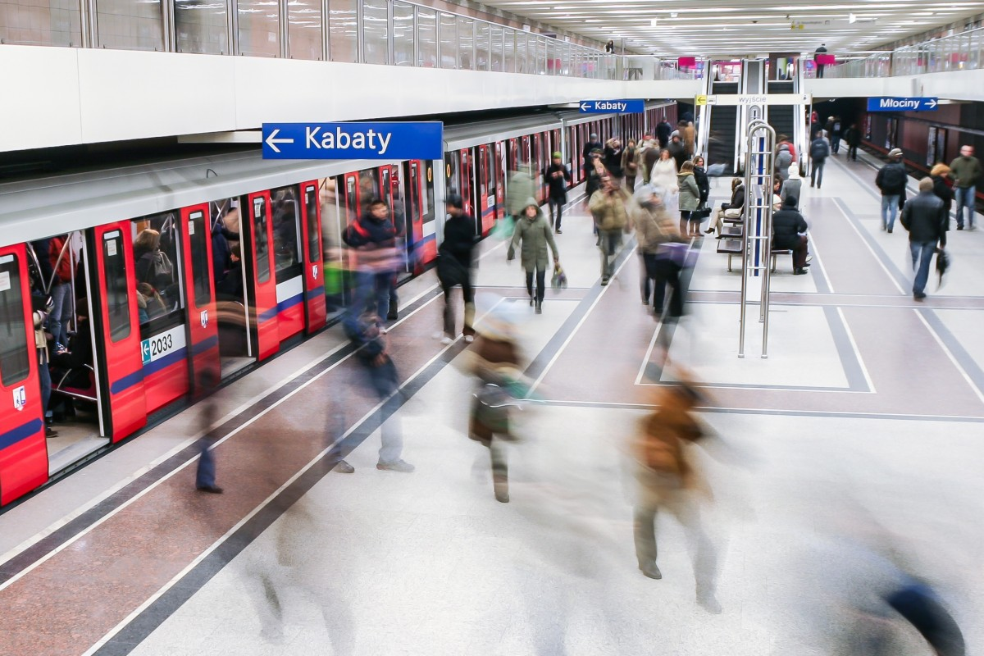

APPLICATION
Integrated all in one guide for tourists and travellers alike.
Less wait time at stations.
Ease of use and digitalized system.
Accessibility at an instant in your hands.
Confusion-free solution to route finding.

Slide 4


A basic template video showcasing the project’s application features.

Slide 5
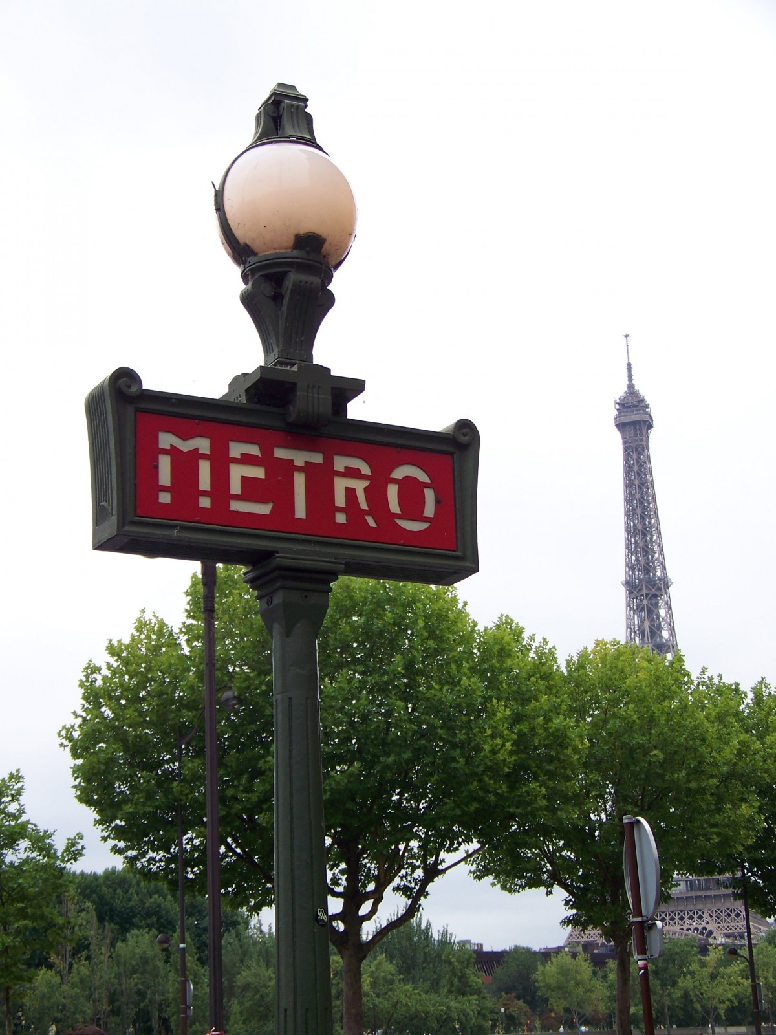
Thank you!
Mobilon- sanya wadhawan

